Slide 1



COMBINING DATA
Alibek Kruglikov

Slide 2

AGENDA
JOINs Review
Multiple JOINs
Subqueries
Exercises

Slide 3
JOINs Review

Slide 4
RECAP ON JOINS
USING (CustomerID)
SELECT * FROM vehicles AS V JOIN customers AS C ON V.CustomerID = C.CustomerID
vehicles
customers
VIN | CustomerID | Make | Model | Year
J314ACK9 | C001782 | Honda | CRV | 2020
VYT4NT42 | C000965 | Toyota | Corolla | 2018
8R91MA8U | C001782 | Mazda | RX5 | 2019
B7X82R41 | C001331 | Toyota | Corolla | 2022
GF328WT9 | C001564 | Honda | Pilot | 2021
CustomerID | FirstName | LastName | Phone
C001782 | Brad | Pitt | 555-1234
C001331 | Albert | Einstein | 555-9876
C000748 | Homer | Simpson | 555-7885
C001564 | Edmund | Dantes | 555-2880
VIN | CustomerID | Make | Model | Year | CustomerID | FirstName | LastName | Phone
J314ACK9 | C001782 | Honda | CRV | 2020 | C001782 | Brad | Pitt | 555-1234
8R91MA8U | C001782 | Mazda | RX5 | 2019 | C001782 | Brad | Pitt | 555-1234
B7X82R41 | C001331 | Toyota | Corolla | 2022 | C001331 | Albert | Einstein | 555-9876
GF328WT9 | C001564 | Honda | Pilot | 2021 | C001564 | Edmund | Dantes | 555-2880

Slide 5
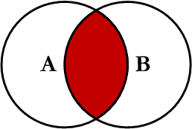
INNER JOIN
SELECT * FROM vehicles AS V JOIN customers AS C …
vehicles
customers
VIN | CustomerID | Make | Model | Year
J314ACK9 | C001782 | Honda | CRV | 2020
VYT4NT42 | C000965 | Toyota | Corolla | 2018
8R91MA8U | C001782 | Mazda | RX5 | 2019
B7X82R41 | C001331 | Toyota | Corolla | 2022
GF328WT9 | C001564 | Honda | Pilot | 2021
CustomerID | FirstName | LastName | Phone
C001782 | Brad | Pitt | 555-1234
C001331 | Albert | Einstein | 555-9876
C000748 | Homer | Simpson | 555-7885
C001564 | Edmund | Dantes | 555-2880
VIN | CustomerID | Make | Model | Year | CustomerID | FirstName | LastName | Phone
J314ACK9 | C001782 | Honda | CRV | 2020 | C001782 | Brad | Pitt | 555-1234
8R91MA8U | C001782 | Mazda | RX5 | 2019 | C001782 | Brad | Pitt | 555-1234
B7X82R41 | C001331 | Toyota | Corolla | 2022 | C001331 | Albert | Einstein | 555-9876
GF328WT9 | C001564 | Honda | Pilot | 2021 | C001564 | Edmund | Dantes | 555-2880

Slide 6
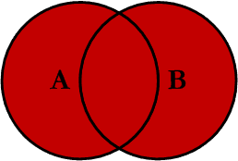
FULL OUTER JOIN
SELECT * FROM vehicles AS V FULL OUTER JOIN customers AS C …
vehicles
customers
VIN | CustomerID | Make | Model | Year
J314ACK9 | C001782 | Honda | CRV | 2020
VYT4NT42 | C000965 | Toyota | Corolla | 2018
8R91MA8U | C001782 | Mazda | RX5 | 2019
B7X82R41 | C001331 | Toyota | Corolla | 2022
GF328WT9 | C001564 | Honda | Pilot | 2021
CustomerID | FirstName | LastName | Phone
C001782 | Brad | Pitt | 555-1234
C001331 | Albert | Einstein | 555-9876
C000748 | Homer | Simpson | 555-7885
C001564 | Edmund | Dantes | 555-2880
VIN | CustomerID | Make | Model | Year | CustomerID | FirstName | LastName | Phone
J314ACK9 | C001782 | Honda | CRV | 2020 | C001782 | Brad | Pitt | 555-1234
VYT4NT42 | C000965 | Toyota | Corolla | 2018 | null | null | null | null
8R91MA8U | C001782 | Mazda | RX5 | 2019 | C001782 | Brad | Pitt | 555-1234
B7X82R41 | C001331 | Toyota | Corolla | 2022 | C001331 | Albert | Einstein | 555-9876
GF328WT9 | C001564 | Honda | Pilot | 2021 | C001564 | Edmund | Dantes | 555-2880
null | null | null | null | null | C000748 | Homer | Simpson | 555-7885

Slide 7
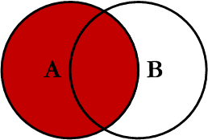
LEFT JOIN
SELECT * FROM vehicles AS V LEFT JOIN customers AS C …
vehicles
customers
VIN | CustomerID | Make | Model | Year
J314ACK9 | C001782 | Honda | CRV | 2020
VYT4NT42 | C000965 | Toyota | Corolla | 2018
8R91MA8U | C001782 | Mazda | RX5 | 2019
B7X82R41 | C001331 | Toyota | Corolla | 2022
GF328WT9 | C001564 | Honda | Pilot | 2021
CustomerID | FirstName | LastName | Phone
C001782 | Brad | Pitt | 555-1234
C001331 | Albert | Einstein | 555-9876
C000748 | Homer | Simpson | 555-7885
C001564 | Edmund | Dantes | 555-2880
VIN | CustomerID | Make | Model | Year | CustomerID | FirstName | LastName | Phone
J314ACK9 | C001782 | Honda | CRV | 2020 | C001782 | Brad | Pitt | 555-1234
VYT4NT42 | C000965 | Toyota | Corolla | 2018 | null | null | null | null
8R91MA8U | C001782 | Mazda | RX5 | 2019 | C001782 | Brad | Pitt | 555-1234
B7X82R41 | C001331 | Toyota | Corolla | 2022 | C001331 | Albert | Einstein | 555-9876
GF328WT9 | C001564 | Honda | Pilot | 2021 | C001564 | Edmund | Dantes | 555-2880

Slide 8
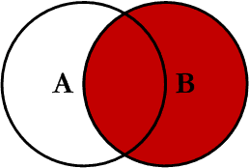
RIGHT JOIN
SELECT * FROM vehicles AS V RIGHT JOIN customers AS C …
vehicles
customers
VIN | CustomerID | Make | Model | Year
J314ACK9 | C001782 | Honda | CRV | 2020
VYT4NT42 | C000965 | Toyota | Corolla | 2018
8R91MA8U | C001782 | Mazda | RX5 | 2019
B7X82R41 | C001331 | Toyota | Corolla | 2022
GF328WT9 | C001564 | Honda | Pilot | 2021
CustomerID | FirstName | LastName | Phone
C001782 | Brad | Pitt | 555-1234
C001331 | Albert | Einstein | 555-9876
C000748 | Homer | Simpson | 555-7885
C001564 | Edmund | Dantes | 555-2880
VIN | CustomerID | Make | Model | Year | CustomerID | FirstName | LastName | Phone
J314ACK9 | C001782 | Honda | CRV | 2020 | C001782 | Brad | Pitt | 555-1234
8R91MA8U | C001782 | Mazda | RX5 | 2019 | C001782 | Brad | Pitt | 555-1234
B7X82R41 | C001331 | Toyota | Corolla | 2022 | C001331 | Albert | Einstein | 555-9876
GF328WT9 | C001564 | Honda | Pilot | 2021 | C001564 | Edmund | Dantes | 555-2880
null | null | null | null | null | C000748 | Homer | Simpson | 555-7885

Slide 9
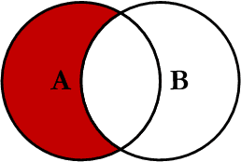
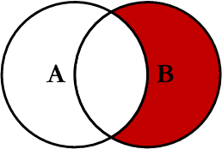
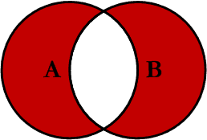
EXCLUDING JOINS
LEFT EXCLUDING JOIN
Data in table A but not table B
… WHERE B.key IS NULL
RIGHT EXCLUDING JOIN
Data in table B but not table A
… WHERE A.key IS NULL
OUTER EXCLUDING JOIN
Data from both tables without intersection
… WHERE A.key IS NULL OR B.key IS NULL

Slide 10
Multiple JOINs

Slide 11
MULTIPLE JOINS
Sometimes we need to combine data from more than two tables, e.g. combining Customers, Services and Vehicles
customers
CustomerID | FirstName | LastName | Phone
C001782 | Brad | Pitt | 555-1234
C001331 | Albert | Einstein | 555-9876
C000748 | Homer | Simpson | 555-7885
C001564 | Edmund | Dantes | 555-2880
services
Invoice | Date | VIN | Service | Amount
20220544 | 2022-02-07 | B7X82R41 | Oil change | $75.46
20220545 | 2022-04-10 | 8R91MA8U | Safety check | $120.51
20220546 | 2022-05-17 | B7X82R41 | Brake pads | $309.28
20220547 | 2022-07-30 | VYT4NT42 | Oil change | $75.46
20220548 | 2022-08-27 | PF43EW5D | Package 2 | $211.73
20220549 | 2022-11-04 | J314ACK9 | Winter tires | $58.41
vehicles
VIN | CustomerID | Make | Model | Year
J314ACK9 | C001782 | Honda | CRV | 2020
VYT4NT42 | C000965 | Toyota | Corolla | 2018
8R91MA8U | C001782 | Mazda | RX5 | 2019
B7X82R41 | C001331 | Toyota | Corolla | 2022
GF328WT9 | C001564 | Honda | Pilot | 2021

Slide 12
MULTIPLE JOINS
services
vehicles
customers
Invoice | Date | VIN | Service | Amount | Make | Model | Year | CustomerID | FirstName | LastName | Phone
20220544 | 2022-02-07 | B7X82R41 | Oil change | $75.46 | Toyota | Corolla | 2022 | C001331 | Albert | Einstein | 555-9876
20220545 | 2022-04-10 | 8R91MA8U | Safety check | $120.51 | Mazda | RX5 | 2019 | C001782 | Brad | Pitt | 555-1234
20220546 | 2022-05-17 | B7X82R41 | Brake pads | $309.28 | Toyota | Corolla | 2022 | C001331 | Albert | Einstein | 555-9876
20220547 | 2022-07-30 | VYT4NT42 | Oil change | $75.46 | Toyota | Corolla | 2018 | C000965 | null | null | null
20220548 | 2022-08-27 | PF43EW5D | Package 2 | $211.73 | null | null | null | null | null | null | null
20220549 | 2022-11-04 | J314ACK9 | Winter tires | $58.41 | Honda | CRV | 2020 | C001782 | Brad | Pitt | 555-1234
null | null | GF328WT9 | null | null | Honda | Pilot | 2021 | C001564 | Edmund | Dantes | 555-2880
SELECT *
FROM services
FULL OUTER JOIN vehicles ON services.VIN = vehicles.VIN
FULL OUTER JOIN customers ON vehicles.CustomerID = customers.CustomerID

Slide 13
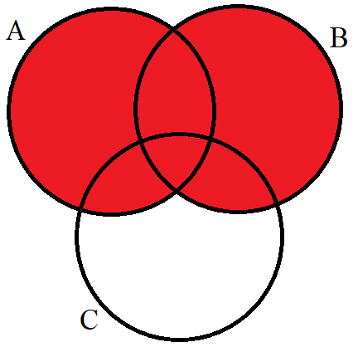
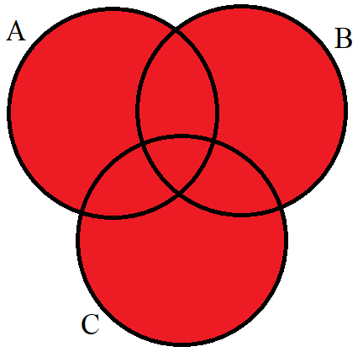
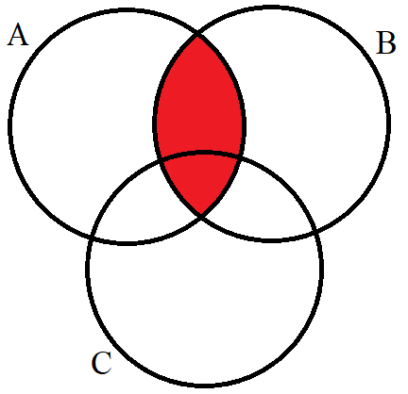
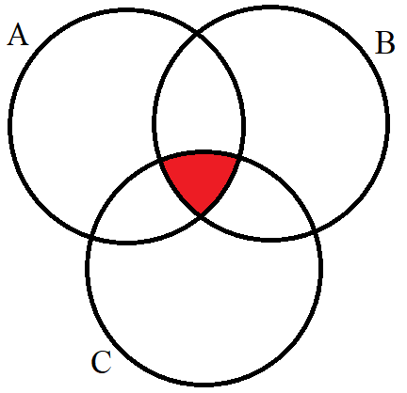
MULTIPLE JOINS
SELECT *
FROM A
FULL OUTER JOIN B ON A.key = B.key
FULL OUTER JOIN C ON B.key2 = C.key2
SELECT *
FROM A
JOIN B ON A.key = B.key
JOIN C ON B.key2 = C.key2

Slide 14
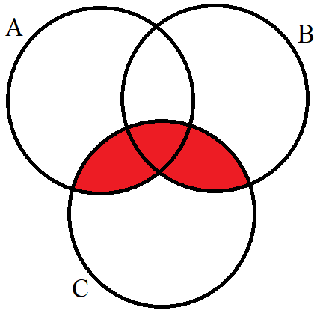
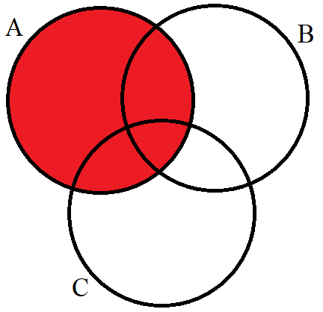
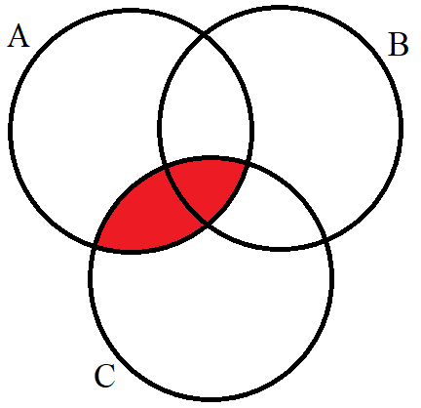
MULTIPLE JOINS
SELECT *
FROM A
FULL OUTER JOIN B ON A.key = B.key
JOIN C ON B.key2 = C.key2
SELECT *
FROM A
LEFT JOIN B ON A.key = B.key
JOIN C ON B.key2 = C.key2

Slide 15
Multiple JOINs – Exercises

Slide 16
MULTIPLE JOINS – EXERCISES
Using the Northwind Database:
Examine the employees, employeeterritories, and territories tables
Show all employeeids and their territoryid (including possible nulls)
Show each employee full name and their territorydescription
Show each employee full name and their regiondescription

Slide 17
Subqueries

Slide 18
WHAT IS A SUBQUERY
Subquery (or “nested” query) is a query that is located inside another query
Can be used to simplify queries (and avoid JOINs)
Can return anything a normal query can: single values, single/multiple rows, single/multiple columns, entire tables
May be difficult to understand when reading code
query
SELECT * FROM table WHERE id IN (SELECT id FROM table)
subquery

Slide 19
SELECT SUBQUERY
SELECT col1, col2, [SUBQUERY]
FROM table1
E.g. Make a table with product names, units in stock and average units in stock for all products

Slide 20
FROM SUBQUERY
SELECT col1, col2
FROM [SUBQUERY]
E.g. Find average price of products with units in stock above average

Slide 21
WHERE SUBQUERY
SELECT col1, col2
FROM table1
WHERE col3 IN [SUBQUERY]
E.g. List information on products that had a discount > 0.20 at least once

Slide 22
Break Time!
<<10:00>>
Notes:
Timer works with extension “Slides Timer”

Slide 23
Subqueries – Exercises

Slide 24
SUBQUERIES – EXERCISES
Using the Northwind Database (try to avoid JOINs):
Show orderid, country and freight difference from overall average freight
Compare average freight of orders to Germany with average freight of orders to France
Show all products (names) with a supplier from Germany
Show orderid and country for orders with higher than average total value (including discount)

